Slide 1
Picture Perfect
Using machine learning
to capture the right picture

Slide 2
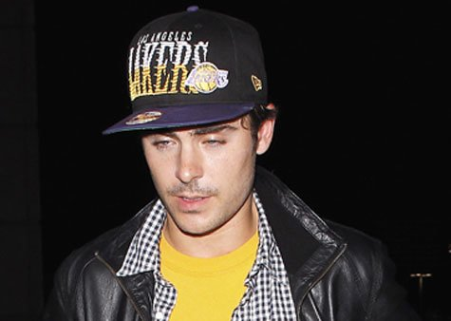
Problem: Bad pictures
Have you ever seen ruined pictures because people accidentally blink or they forget to smile?

Slide 3
Solution: Use machine learning
We can use machine learning to:
Detect when a subject is “ready” (has their eyes open and are smiling) and have the device automatically take a picture
OR
Prevent the device from taking pictures if the subject is “not ready” (person is blinking or not smiling)

Slide 4
Getting started
First we have to find data to train our classifier

Slide 5
The Data Set
Face data was obtained from AT&T Laboratories Cambridge
http://www.cl.cam.ac.uk/research/dtg/attarchive/facedatabase.html
Data is a set of 400 images
40 people with 10 images each
Grayscale images
No class labels given

Slide 6
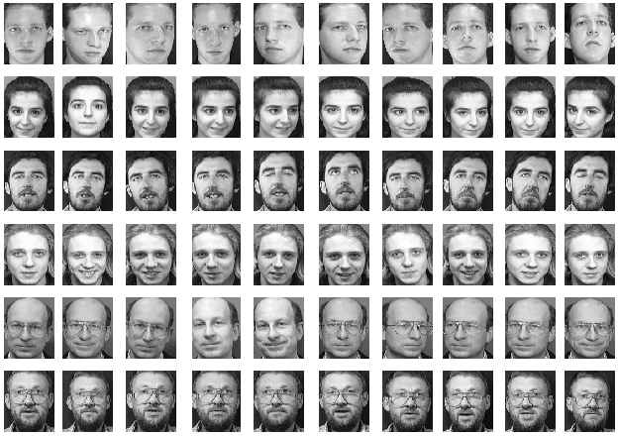
Sample data

Slide 7
First steps
Each image is converted to an array of digits and stored in an array
Class labels are manually assigned to each of the images and stored in another array
For this project, we had two classifications
Whether a person was smiling or not
Whether a person had their eyes open or not

Slide 8
How do we build our classifier?
This is similar to MNIST because it uses images
Images can be converted to a single array of digits
Since a single image contains 10,304 elements, we can use Principal Component Analysis to reduce the dimensionality!

Slide 9
Principal Component Analysis
SK learn was used to calculate the first and second principal components

